Slide 1
Statistics Case study
Group 12
Ashish Lal ( 21BCs017 )
Avinav Kashyap ( 21BCS021 )​
Pratik Kunghadkar ( 21BCS058 )

Slide 2
AGENDA
Introduction​
Dataset
Code
​Summary​

Slide 3
Introduction
Today , nearly each and every home in Indian Families have at least one member is suffering from diabetes. So we have performed Case Study Analysis over the Diabetes causes and reasons. Also the dataset is consisting of some other factors which we will discuss.

Slide 4
Dataset
Diabetes Prediction Dataset
(from https://www.cdc.gov/diabetes/data/index.html)

Slide 5
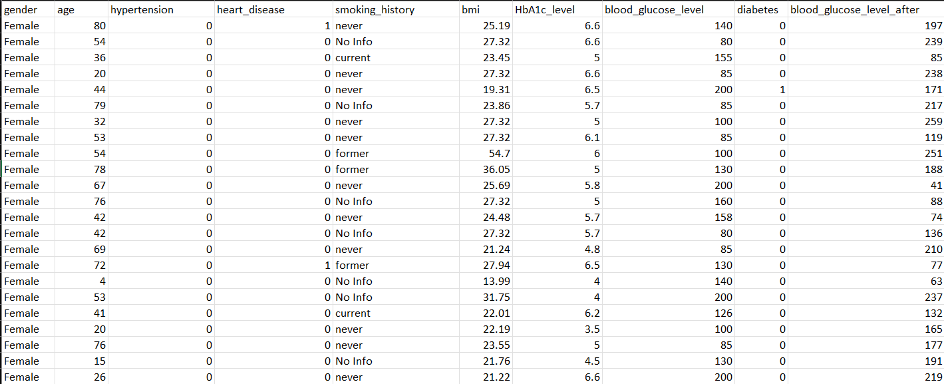
Actual dataset preview

Slide 6
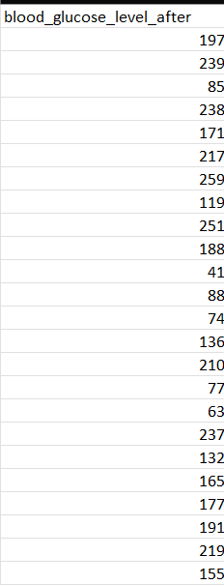
Modified Data
This is the added for performing all the dependency tests , such as paired-sign test.

Slide 7
AREAS OF FOCUS
B2B MARKET SCENARIOS
CLOUD-BASED OPPORTUNITIES
Develop winning strategies to keep ahead of the competition
Capitalize on low-hanging fruit to identify a ballpark value
Visualize customer directed convergence
Iterative approaches to corporate strategy
Establish a management framework from the inside

Slide 8
Code
Unit-II

Slide 9
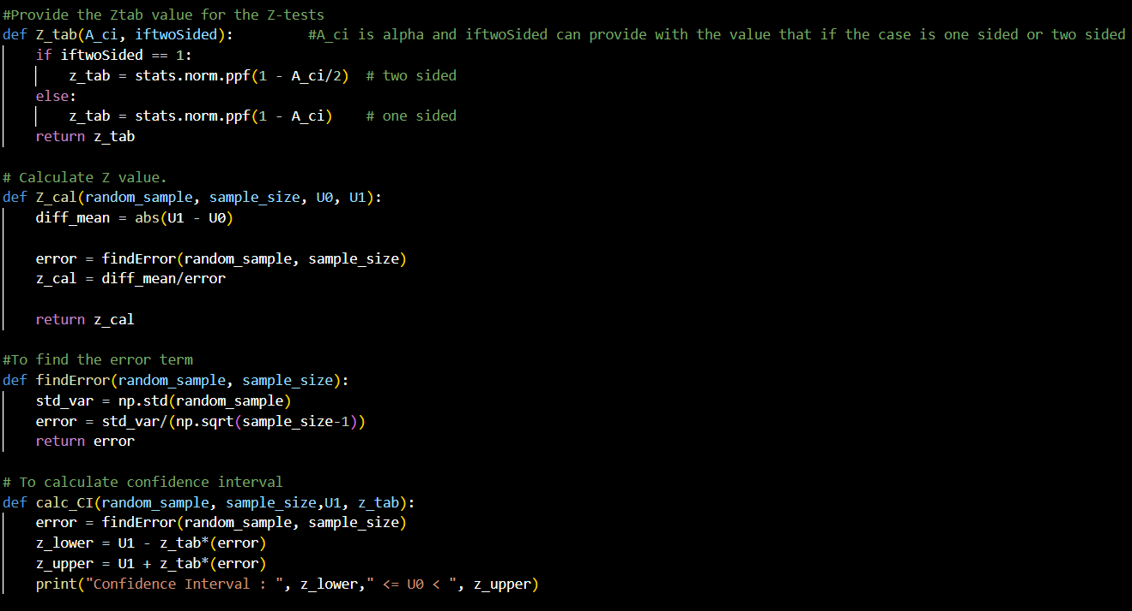
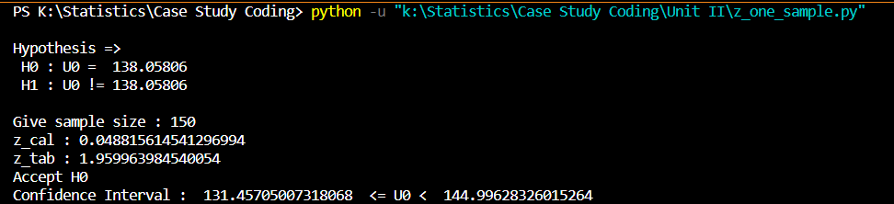
1. Z-test Single Sample Mean
Output

Slide 10
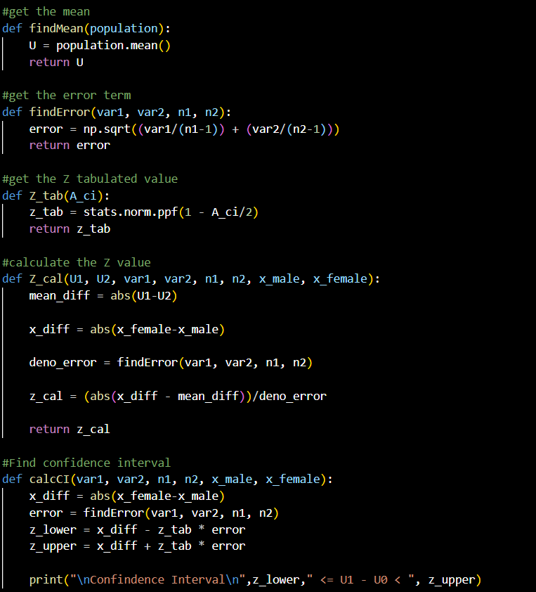
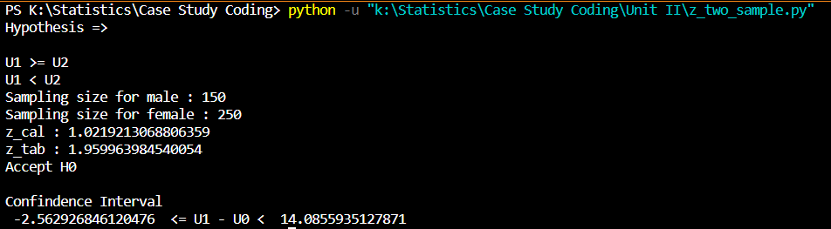
2. Z-test Two Sample mean
Output

Slide 11
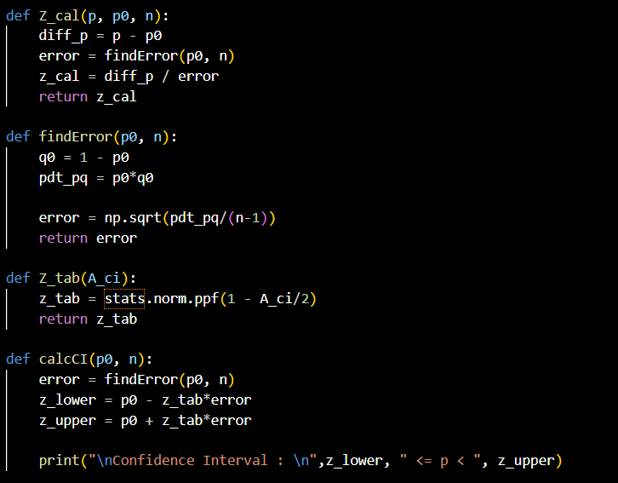
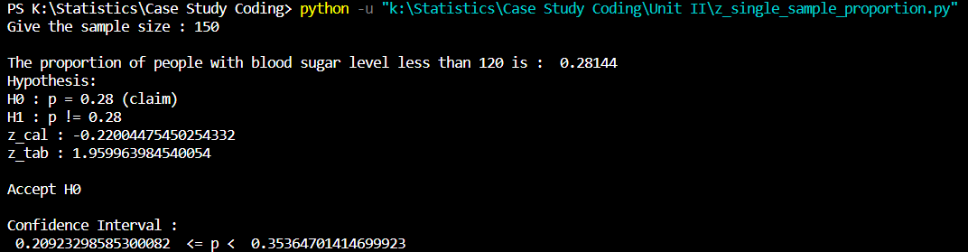
3. Z-test Single Sample proportion
Output

Slide 12
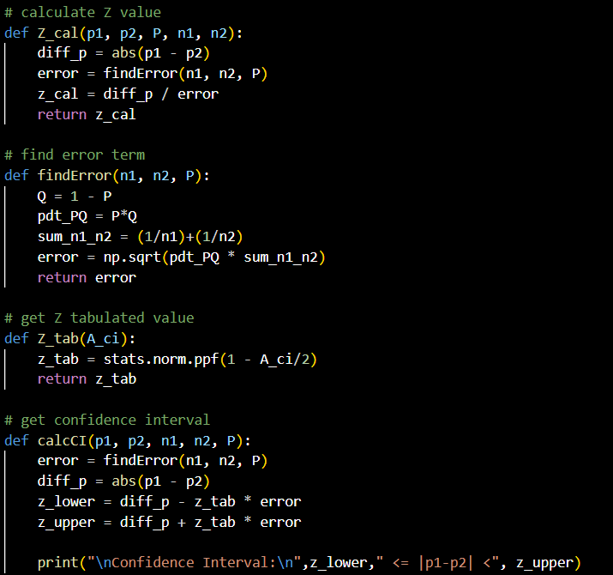
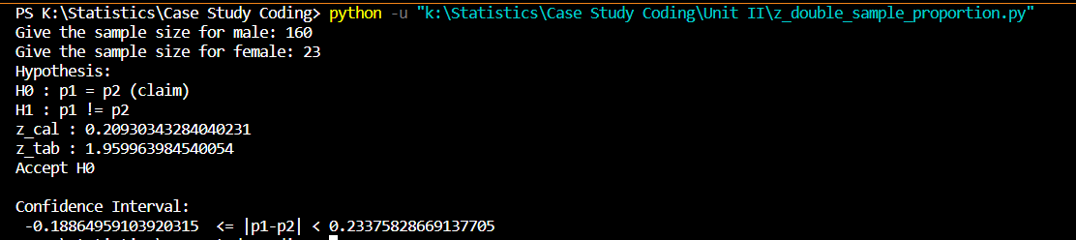
4. Z-test two Sample proportion
Output

Slide 13
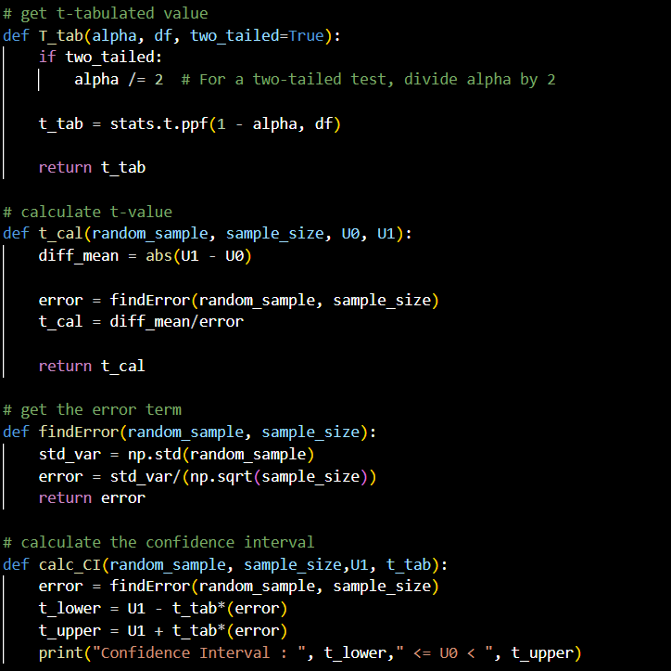
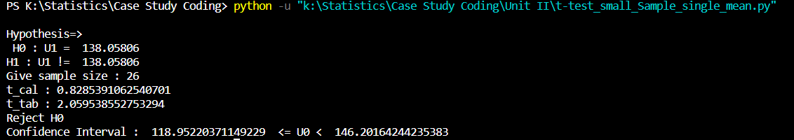
5. t-test Single Sample mean
Output

Slide 14
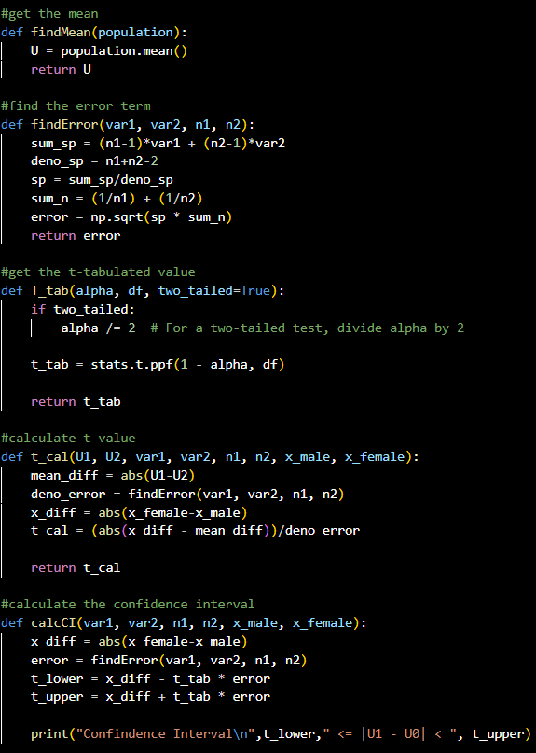
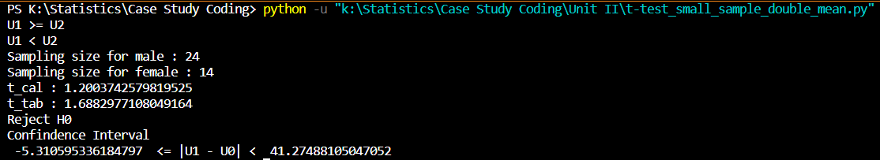
6. t-test two Sample mean
Output

Slide 15
1. Z-test Single Sample
Output

Slide 16
Unit-III

Slide 17
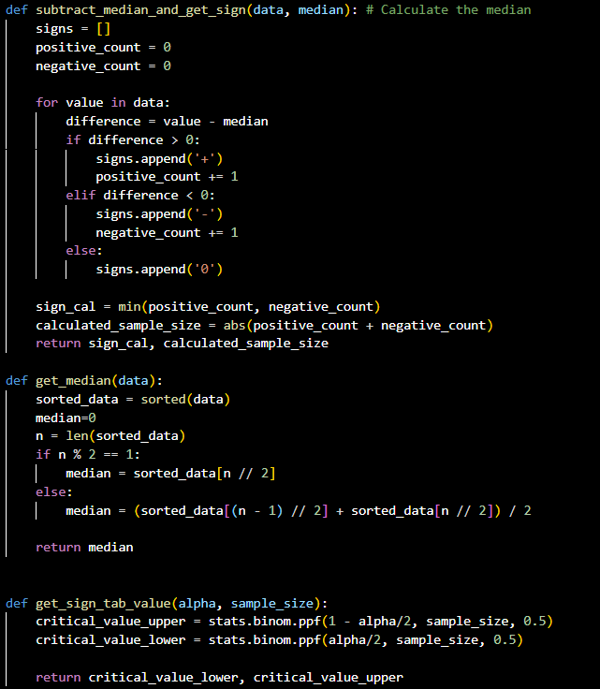
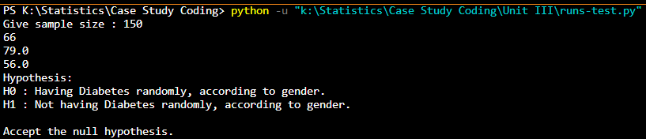
1. Runs test
Output

Slide 18
2. Sign test
Output

Slide 19
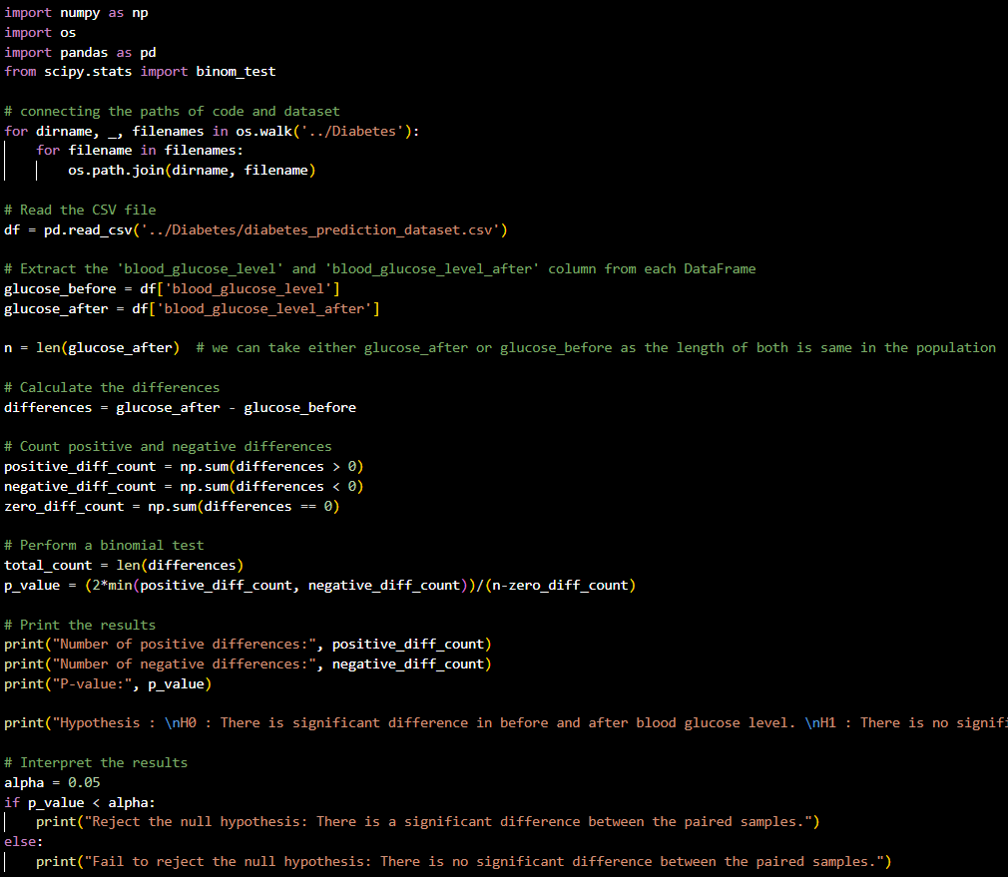
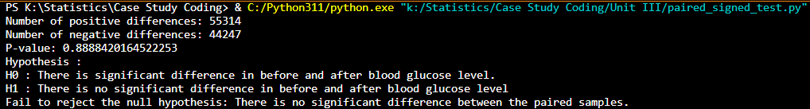
3. paired-sign test
Output

Slide 20
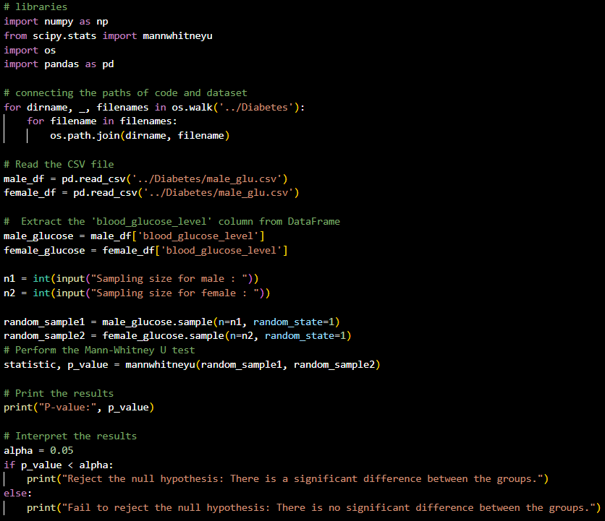
4. Wilcoxon rank sum test or mann-whitney u-test
Output

Slide 21
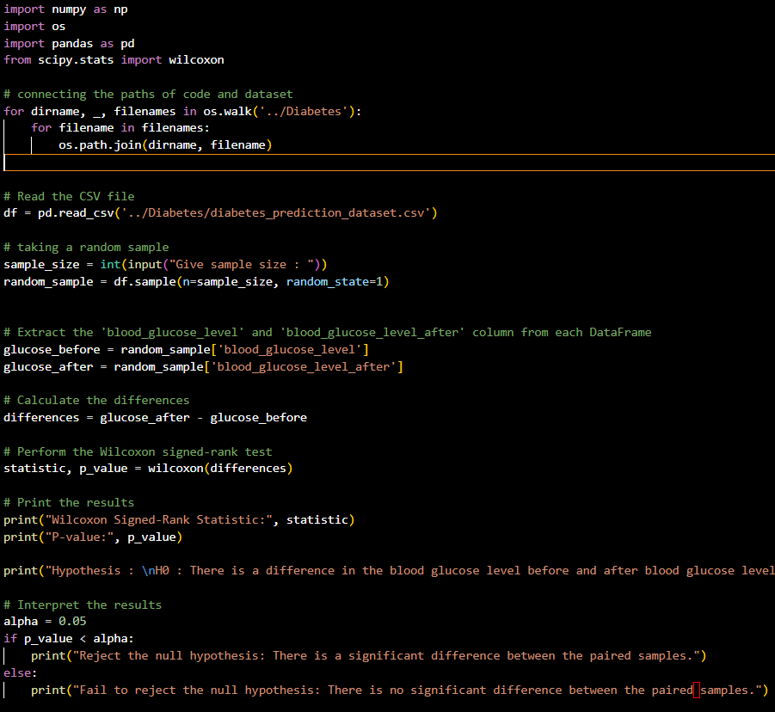
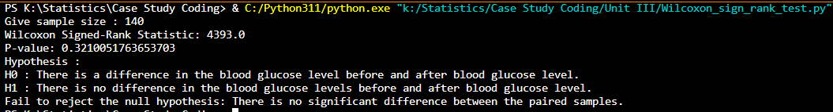
5. Wilcoxon signed-rank test
Output

Slide 22
Unit-IV

Slide 23

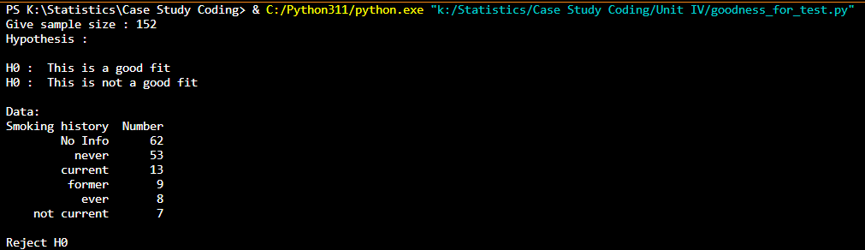
1. Goodness test
Output

Slide 24
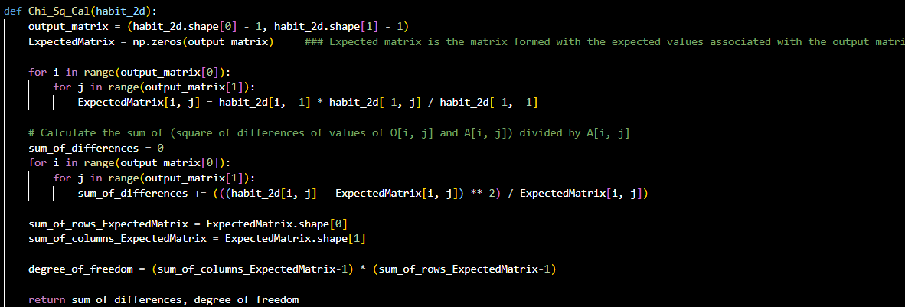
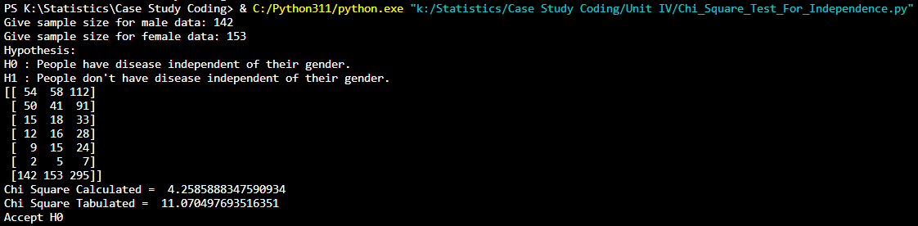
2. chi-square test for independence
Output

Slide 25
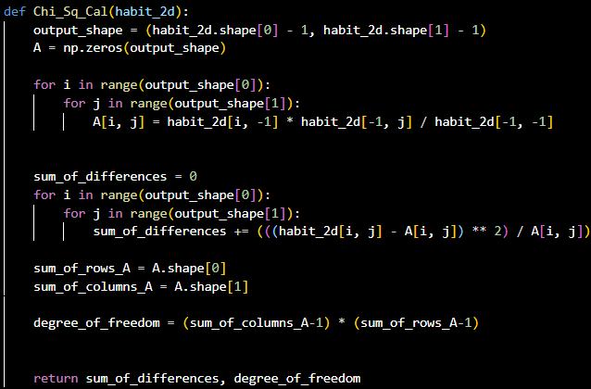
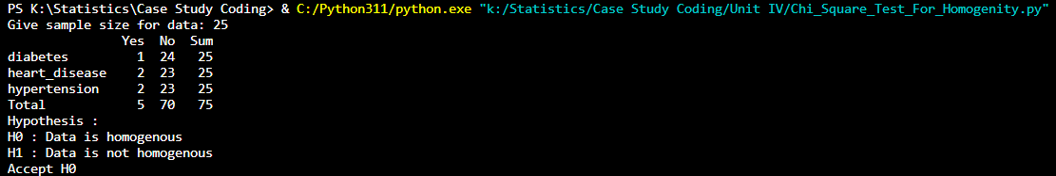
3. Chi-square test for homogeneity
Output

Slide 26
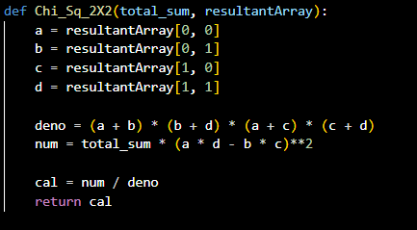
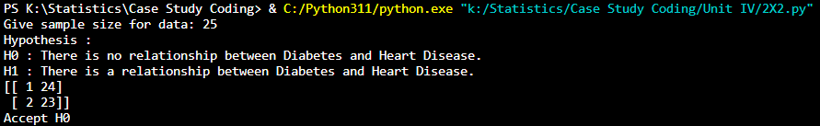
4. chi-square 2x2 contingency test
Output

Slide 27
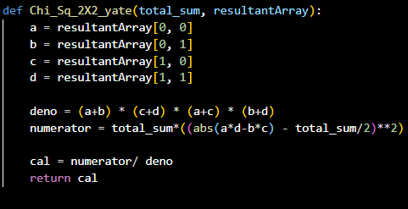
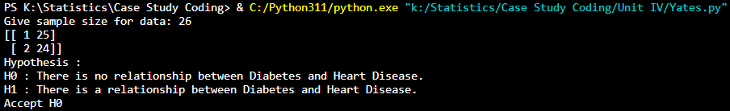
5. chi-square 2x2 contingency test with yate’s correction
Output

Slide 28
Unit-V

Slide 29
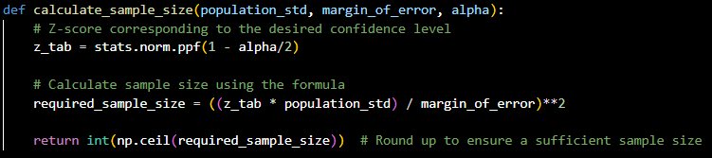
1. Sample size estimation for z-test single mean
Output

Slide 30
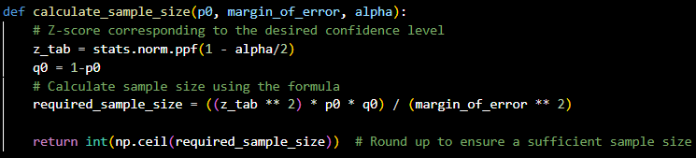
2. Sample size estimation for z-test single proportion
Output

Slide 31
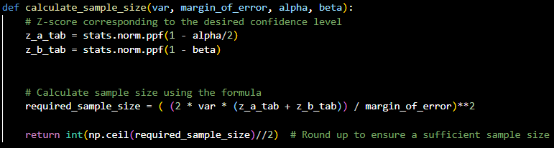
3. Sample size estimation for z-test two mean
Output

Slide 32
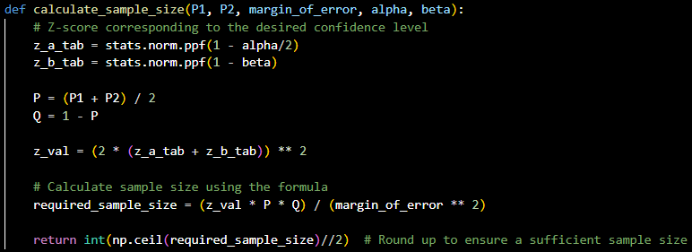
4. Sample size estimation for z-test two sample proportion
Output

Slide 33
SUMMARY
At Contoso, we believe in giving 110%. By using our next-generation data architecture, we help organizations virtually manage agile workflows. We thrive because of our market knowledge and great team behind our product. As our CEO says, "Efficiencies will come from proactively transforming how we do business."

Slide 34
THANK YOU
Mirjam Nilsson​
mirjam@contoso.com
www.contoso.com

